Slide 1
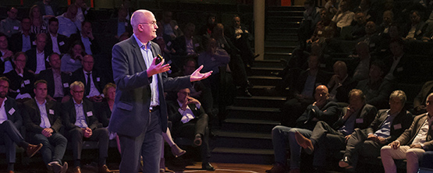
Marius rietdijk
Cultural change with OBM
Marius rietdijk
Cultural change with OBM
Research interests
Scenario Planning, Organizational Theory
The Experimental Analysis of Behavior
Applied Behavior Analysis, Hypnosis, Magic
Organizational Behavior Management (OBM)
Unity of Science
Radical behaviorism as philosophy of science
Dependent variables:
Performance (= Behaviors + results), such as:
Quantity, quality of production and services, safety, happiness
Opportunities for research collaboration
Current management studies characterized by difficult to replicate attitude studies (threat to scientific rigor and societal relevance)
Next step is doing social relevant field experiments that are both rigorous and relevant
I can help you define your measures and interventions for realizing your research potential
This leads to an even higher relevance of your research
In our Executive Education Center ADRIBA we have gathered performance data. If you have experience in high-end publications we can co-publish
Methods & empirics
Improving organizational results by cultural (= behavioral) change. Realized by field experimental designs with following protocol:
Independent variables:
Pinpoint of the performance
Measure of longitudinal baseline pinpoint
Antecedent – Behavior – Consequence (ABC-) Analysis
Ongoing feedback of measures to performers
(Sub-)goal setting
Positive reinforcement of goal attainment
Maintaining and generalizing change across organization, sector and region
Illustration of earlier research output
Decreasing lead time of production and administrative processes
Improving easy to understand reports of lawyers
Improving safety, specified in
- Increased number of reports of unsafe situations
- Increased number of clean work spaces
- Increased percentage of using safe gear
Less complaints, more positive reinforcers, including compliments
Increased positive reinforcement : Punishment ratio
PhD thesis describing state-of-the-art of OBM, including many field studies
Generalizing behavior analysis to the field of investing and compliance
For more information see: www.adriba.nl
www.mariusrietdijk.nl

